Slide 1
















$$μ$$
$$d$$
$$d$$
Re-parameterization
$$Enc$$
$$h$$
$$h$$
$$Dec$$
$$z=μ+σε$$
$$w$$
$$w$$
$$σ$$
$$x∈ℝ^{H∗W∗3}$$
$$z_{1}∈ℝ^{h∗w∗d}$$
$$z∈ℝ^{h∗w∗d}$$
$$\hat{x}∈ℝ^{H∗W∗3}$$

Slide 2
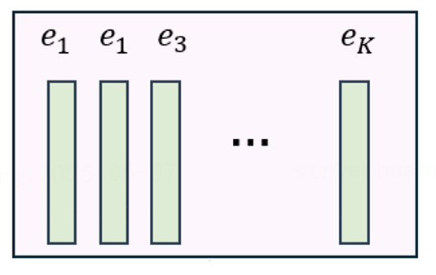




CodeBook
$$d$$
$$w$$
$$d$$
$$Enc$$
$$h$$
$$h$$
$$h$$
$$Dec$$
$$w$$
Token Indices
$$w$$
STE
$$x∈ℝ^{H∗W∗3}$$
$$z_{e}∈ℝ^{h∗w∗d}$$
$$z_{q}∈ℝ^{h∗w∗d}$$
$$\hat{x}∈ℝ^{H∗W∗3}$$

Slide 3







Quantize
DeQuantize
$$Enc$$
$$Dec$$
$$x$$
$$z_{e}∈ℝ^{h∗w∗d}$$
$$(continuous)$$
$$ℝ^{h∗w}$$
$$(discrete token indices)$$
$$z_{q}∈ℝ^{h∗w∗d}$$
$$(continuous)$$
$$\hat{x}$$

